Slide 1
The Enterprise Clown
Builds SharePoint apps with Node.js

Slide 2
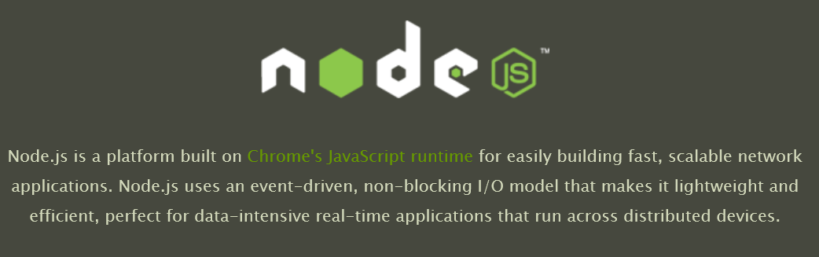

Slide 3
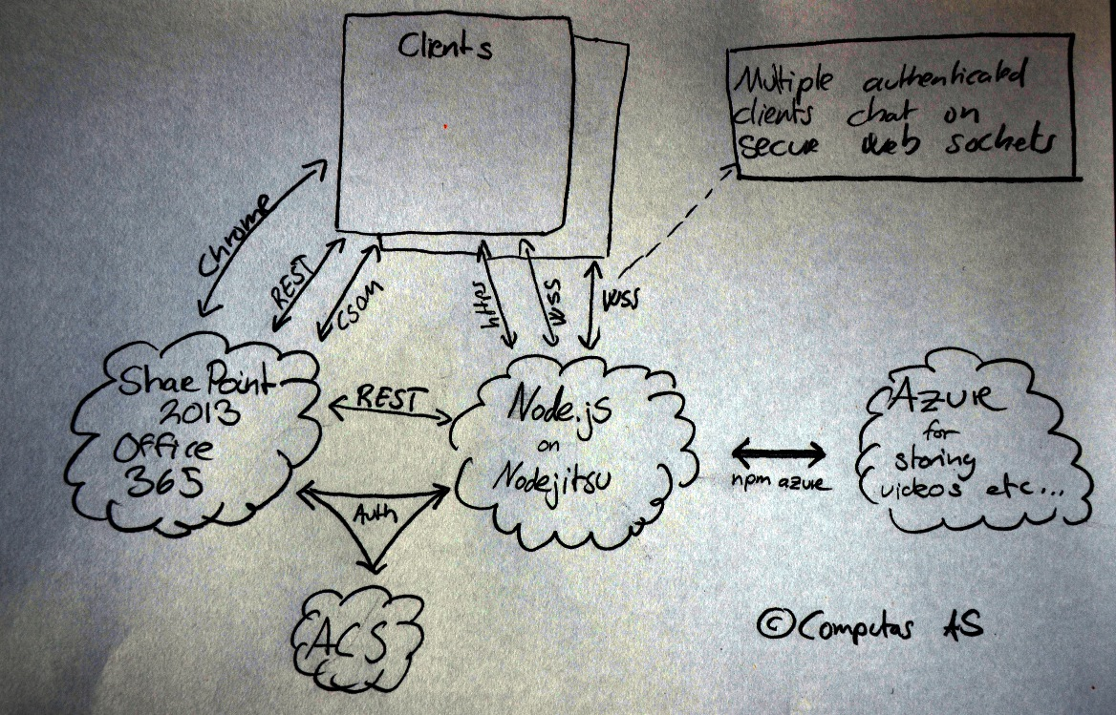

Slide 4
